Slide 1
Visual Insights from FIDE Chess Ratings dataset
- Aravind Kolumum Raja

Slide 2
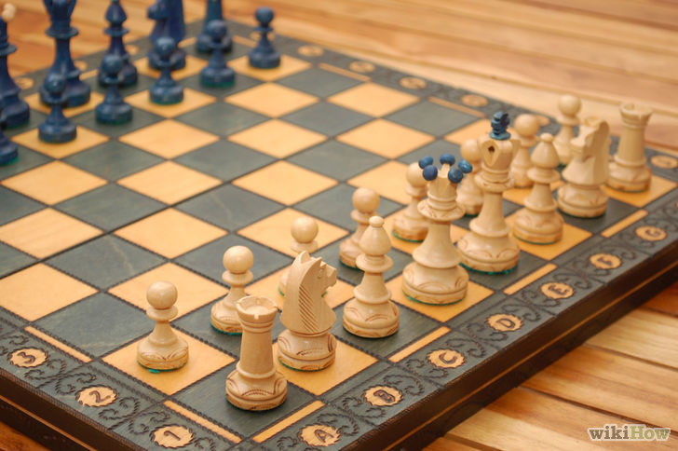
History, facts and features
Originated in India , developed into
The modern version as we knew it
around the 16th Century.
On a checkered 8X8 Board, your
objective is to surround and checkmate
your king before your opponent does.
Immensely complex, offers a plethora
of strategies and aesthetically pleasing
moves making it a Science, an Art but
ultimately an intense sport.

Slide 3
Average number of legal positions in chess is estimated between 10⁴³ and 10⁴⁷
The number of possible games is much greater. Estimated around 10¹²⁰
Today’s computer algorithms are nowhere near solving chess. However, they have surpassed the capabilities of a human Grandmaster.
Perfect play requires computing power to compare this insanely high number of game variations and is beyond the scope of present technology.
So , even with millions of games played over the past few centuries, the probability that a new unseen board position appears is always likely, thus making Chess an enjoyable sport for many centuries to come.

Slide 4
The Data
FIDE is World Chess Federation, known by its French acronym Federation Internationale des Echecs. It contains 186 member federations making FIDE one of the largest sports organizations in the world
Ratings across Countries, Activity, Title, Sex and Age for January 2016
Ratings data available in snapshots from previous decades (Jan 1975, Jan 1985,Jan 1995,Jan 2005)

Slide 5

How are ratings calculated
Elo rating system is a method for calculating the relative skill levels of players in competitor-versus-competitor game. Introduced by Hungarian born Physicist Arpad Elo into FIDE in 1971.
A player's Elo rating is represented by a number which increases or decreases depending on the outcome of games between rated players. After every game, the winning player takes points from the losing one.
Expected score= Probability of Winning + ½(Probability of Drawing)
For each 400 rating points of advantage over the opponent, the expected score is magnified ten times in comparison to the opponent's expected score.

Slide 6
How are overall ratings distributed?

Slide 7
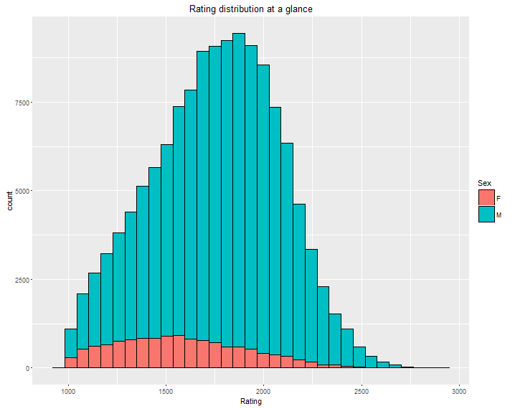
About 11% of all
Active FIDE rated
players are female
Seem to be normally
distributed with a mean
of about 1750 and standard deviation of 320
Density plots can
compare Ratings across
Sex

Slide 8
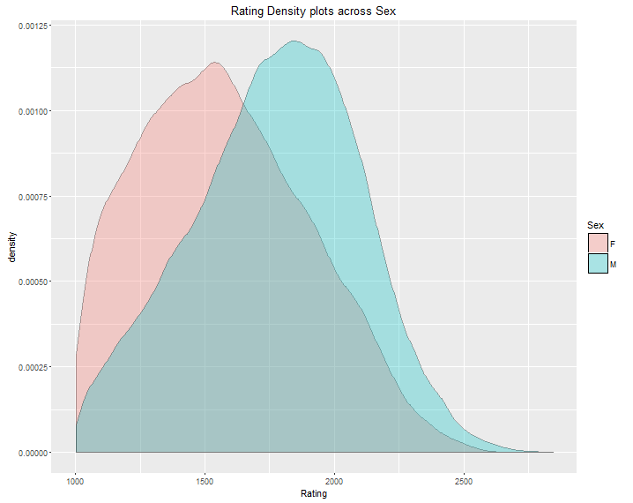
GMs

Slide 9
Who are Masters and Grandmaster?
Title | Requirement | Percentile below (Rating)
Super GM(unofficial) | Elo > 2700 | 99.98%
Grandmaster | Elo > 2500 and 3 Norms | 99.22%
International Master | Elo > 2400 | 97.42%
FIDE Master | Elo > 2300 | 93.81%
Candidate Master | Elo > 2200 | 93.13%

Slide 10
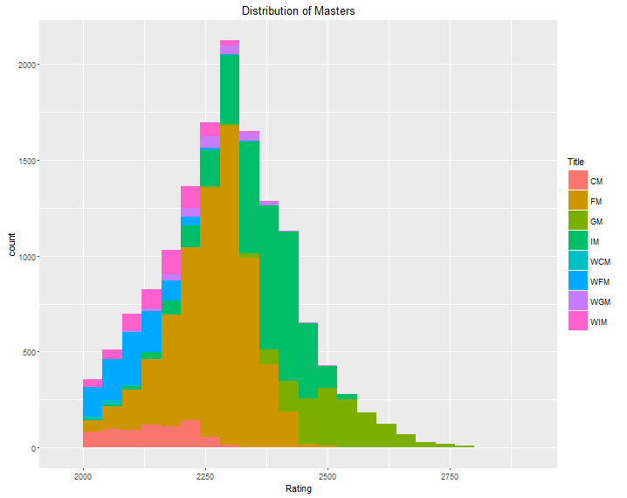

Slide 11
Which countries have the most active Masters?

Slide 12
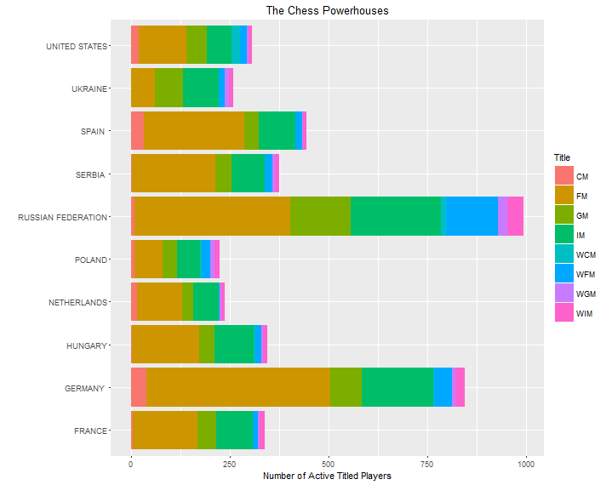

Slide 13
Where can I maximize my chances of running into a Grandmaster?

Slide 14
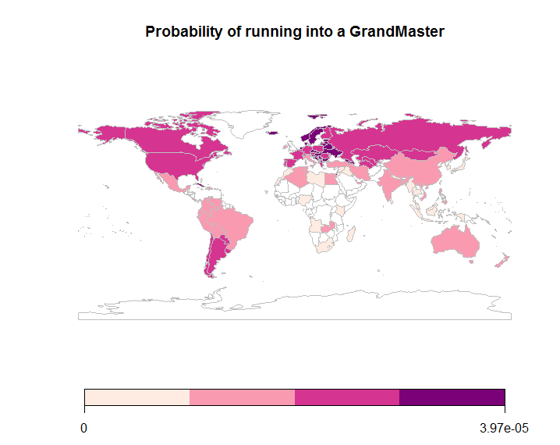

Slide 15
Can we infer something from a player’s age about his/her strength?

Slide 16
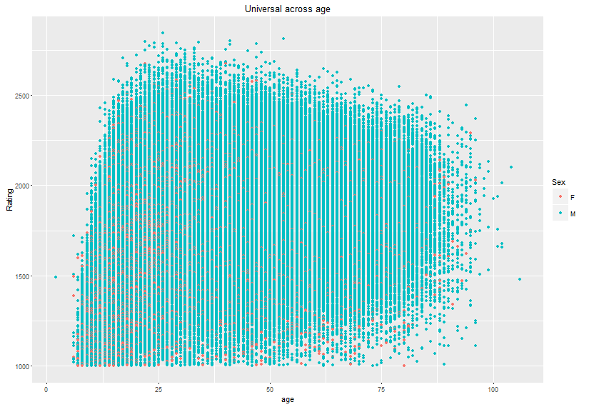

Slide 17
What if you know they are Grandmasters?

Slide 18
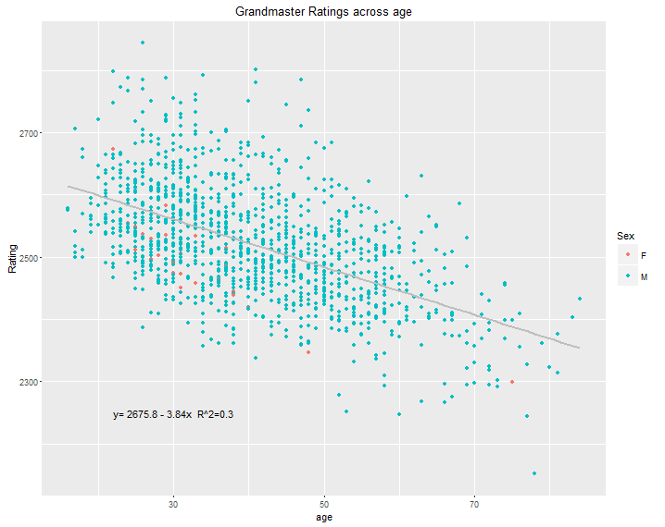
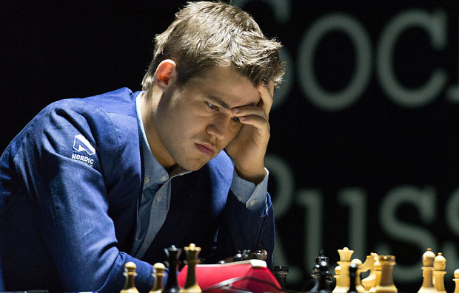
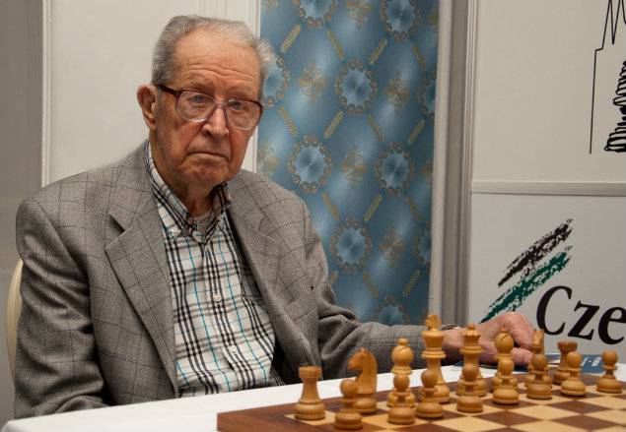
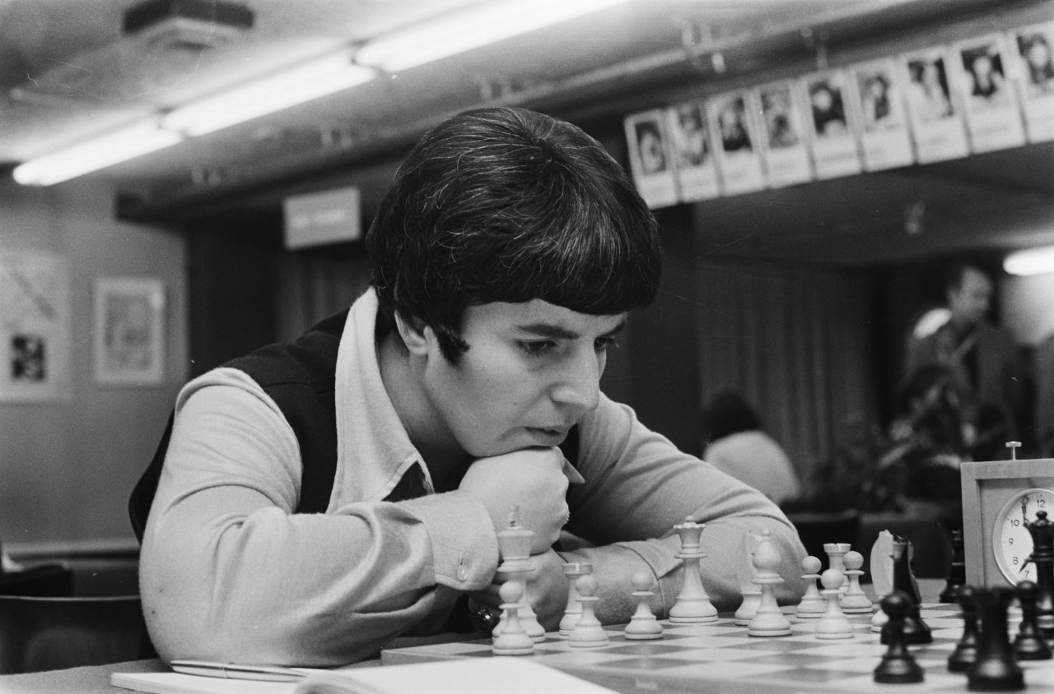
Magnus Carlsen
Yuri Averbakh
Nona Gaprindashvili

Slide 19
Where can you find the younger crowd?

Slide 20
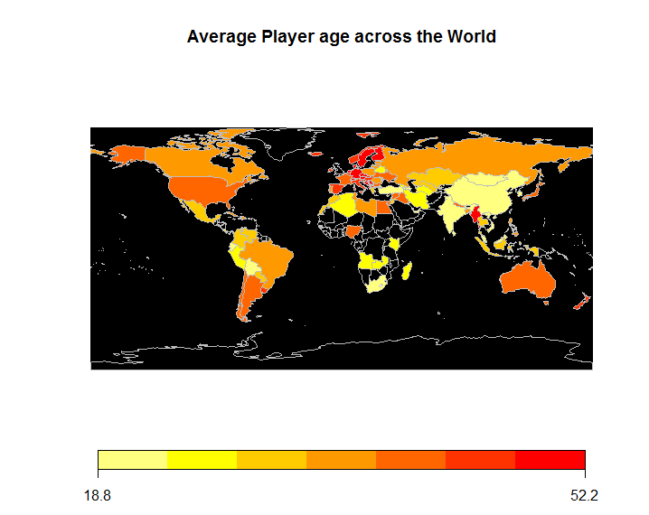

Slide 21
Is there anyplace in the Chess World where you are equally likely to be paired against a Female or a Male?
Gender /Sex Ratio

Slide 22
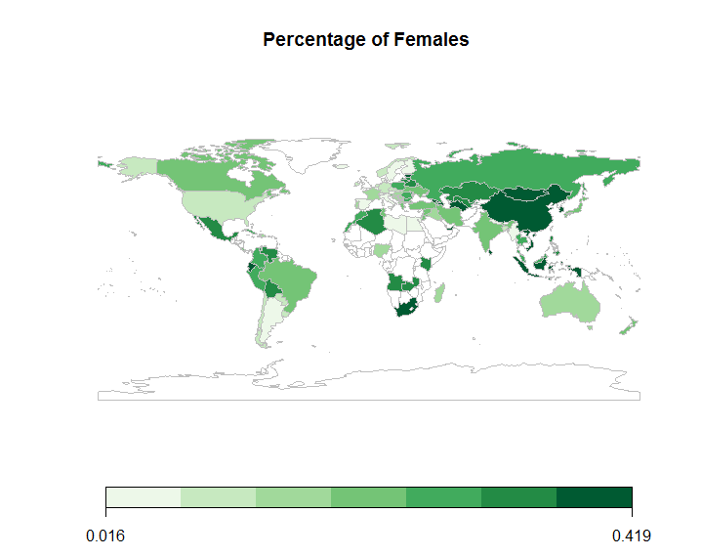
No, but to maximize your
chances, you should
probably head to Vietnam
Or Mongolia.
Avoid Denmark & Switzerland

Slide 23
Why do Rated Female players have statistically significant lower ratings than their Male counterparts?

Slide 24
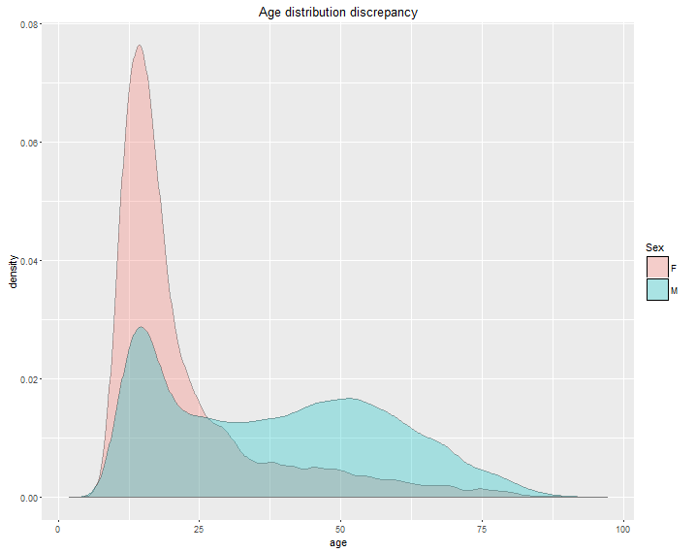
One possible cause:
Women seem to retire far
too early, much before
They can attain their peak
ratings .
The density is concentrated
mostly among players below
The age of 25 after which
there are hardly any women
pursuing Chess in a
Competitive setting.

Slide 25
Visual evidence for Rating inflation among Grandmasters across the years

Slide 26
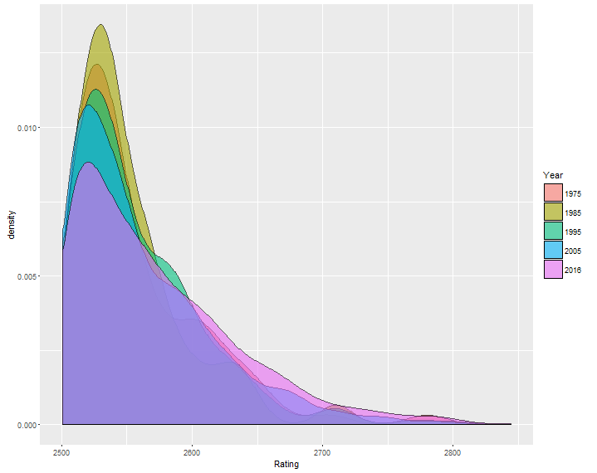
Rating density transformation across years

Slide 27
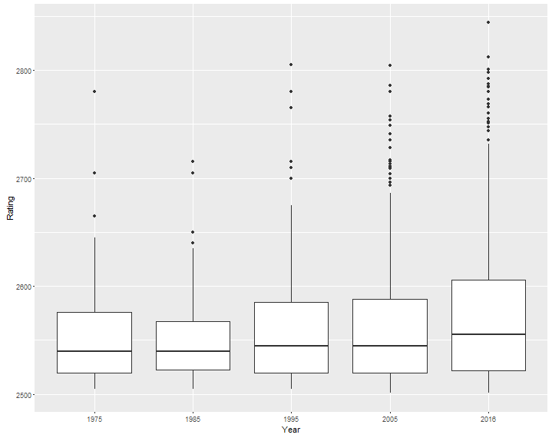
0.03994
Box plot of ratings across 40 years
0.03994
0.04065
Variance tests were run
across successive pairs of
Ratings data 1975-85,
1985-95,1995-05 and 2005-16
Null hypothesis: Ratio of Var=1
Alternative: Ratio is less than 1
and the p values for each pair
were 0.9,0.04,0.04, & 4.3*10⁻⁵

Slide 28
Takeaways
Statistical testing has confirmed the shift in variance of the Ratings curve, further analysis can provide a means to compare players from different eras.
Early retirement of Women in competitive chess must be taken seriously , along with cultural practices and attitudes that prevent women from participating in this sport.
European chess federations must consider promoting more Chess to the younger generation and also encourage women to play chess at a competitive level
Scatterplot confirms the universality of the game, distributed finely across all levels and ages making Chess a very unique sport.

